Slide 1
Sprint 2 Review
Quandl Connectivity

Slide 2
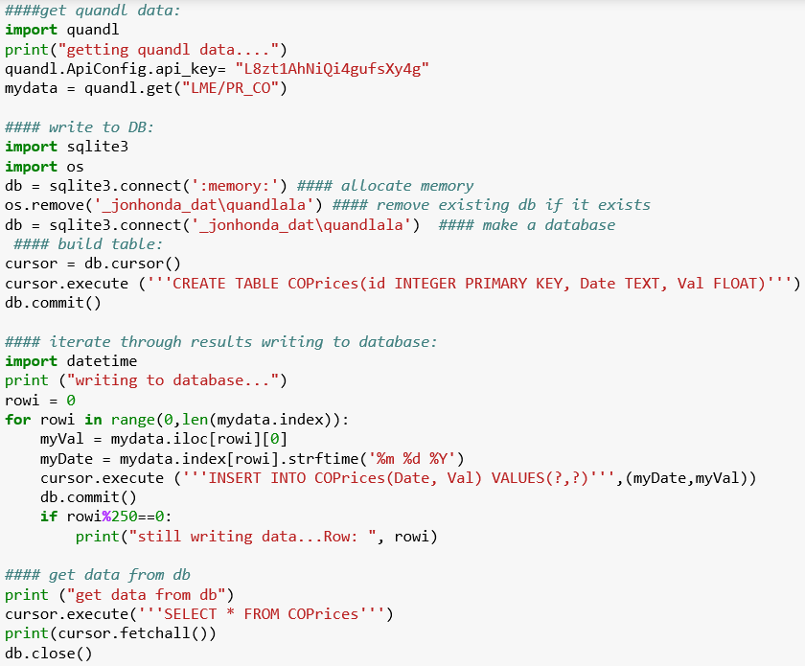
Sprint Objectives (V 2.0)
Get Quadl Data
(Python)
Make Database
Write to Database
Query Database

Slide 3
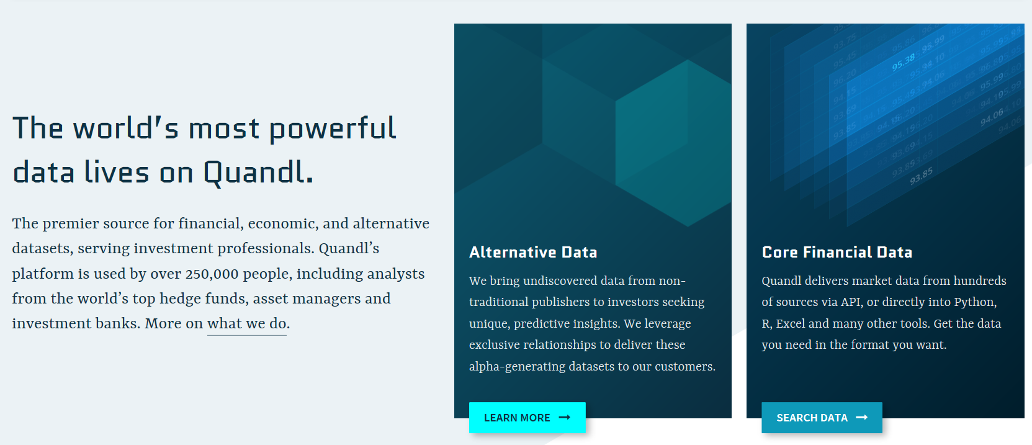

What is…
Get Quadl Data
Make Database
Query Database
Write to Database

Slide 4
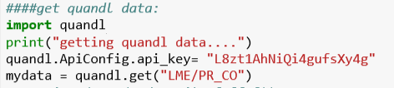
Invoke quandl library
Write to variable
Connect to Quandl API
Get cobalt price data set
Get Quadl Data
Make Database
Query Database
Write to Database

Slide 5
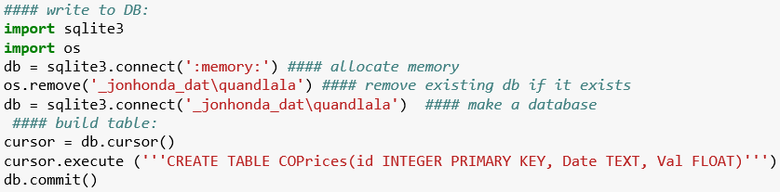
Make DB
Query DB
Write to DB
Get Quadl Data

Slide 17
Fin

